Slide 1

Statistical & Mathematical Methods for Data Science
By
Dr Rafiullah Khan

Slide 2
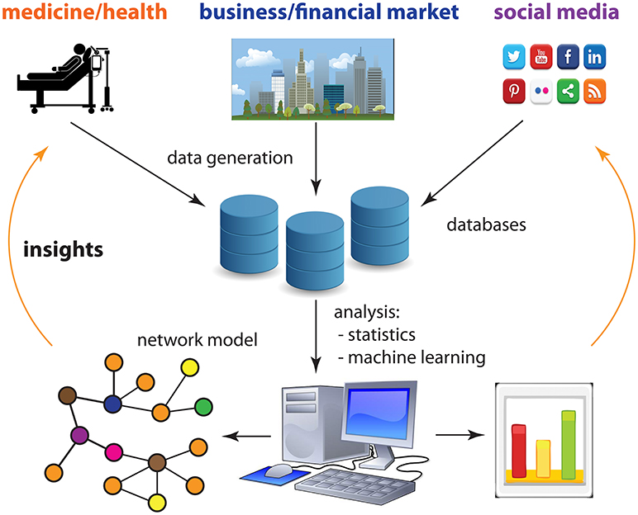
Week 1 Introduction to Data Science

Slide 3
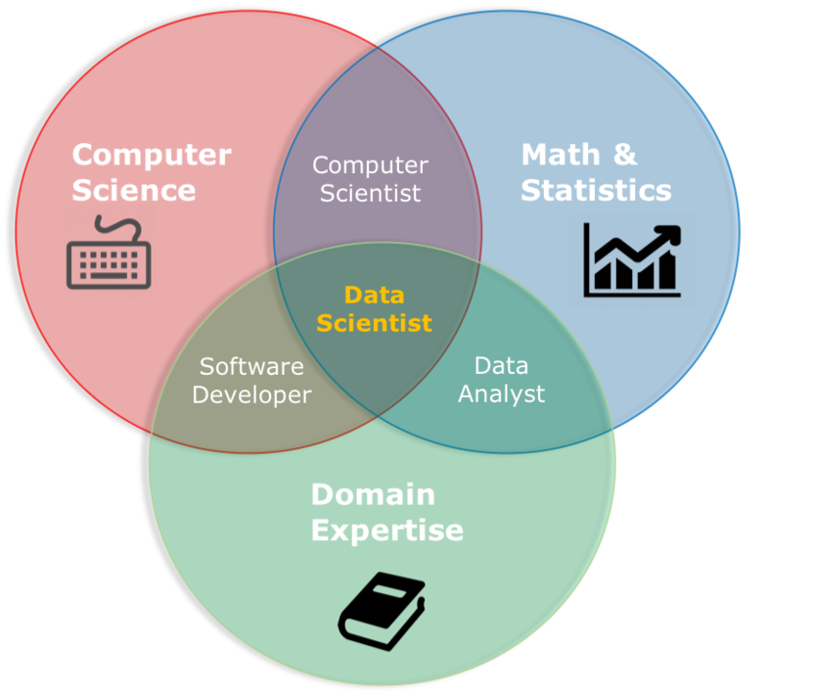
What is Data Science?
Data Science is the study of extracting insights and knowledge from data.
Involves statistics, machine learning, and data analysis.
Example: Data Science can be used to predict customer behavior in marketing by analyzing historical sales data.

Slide 4
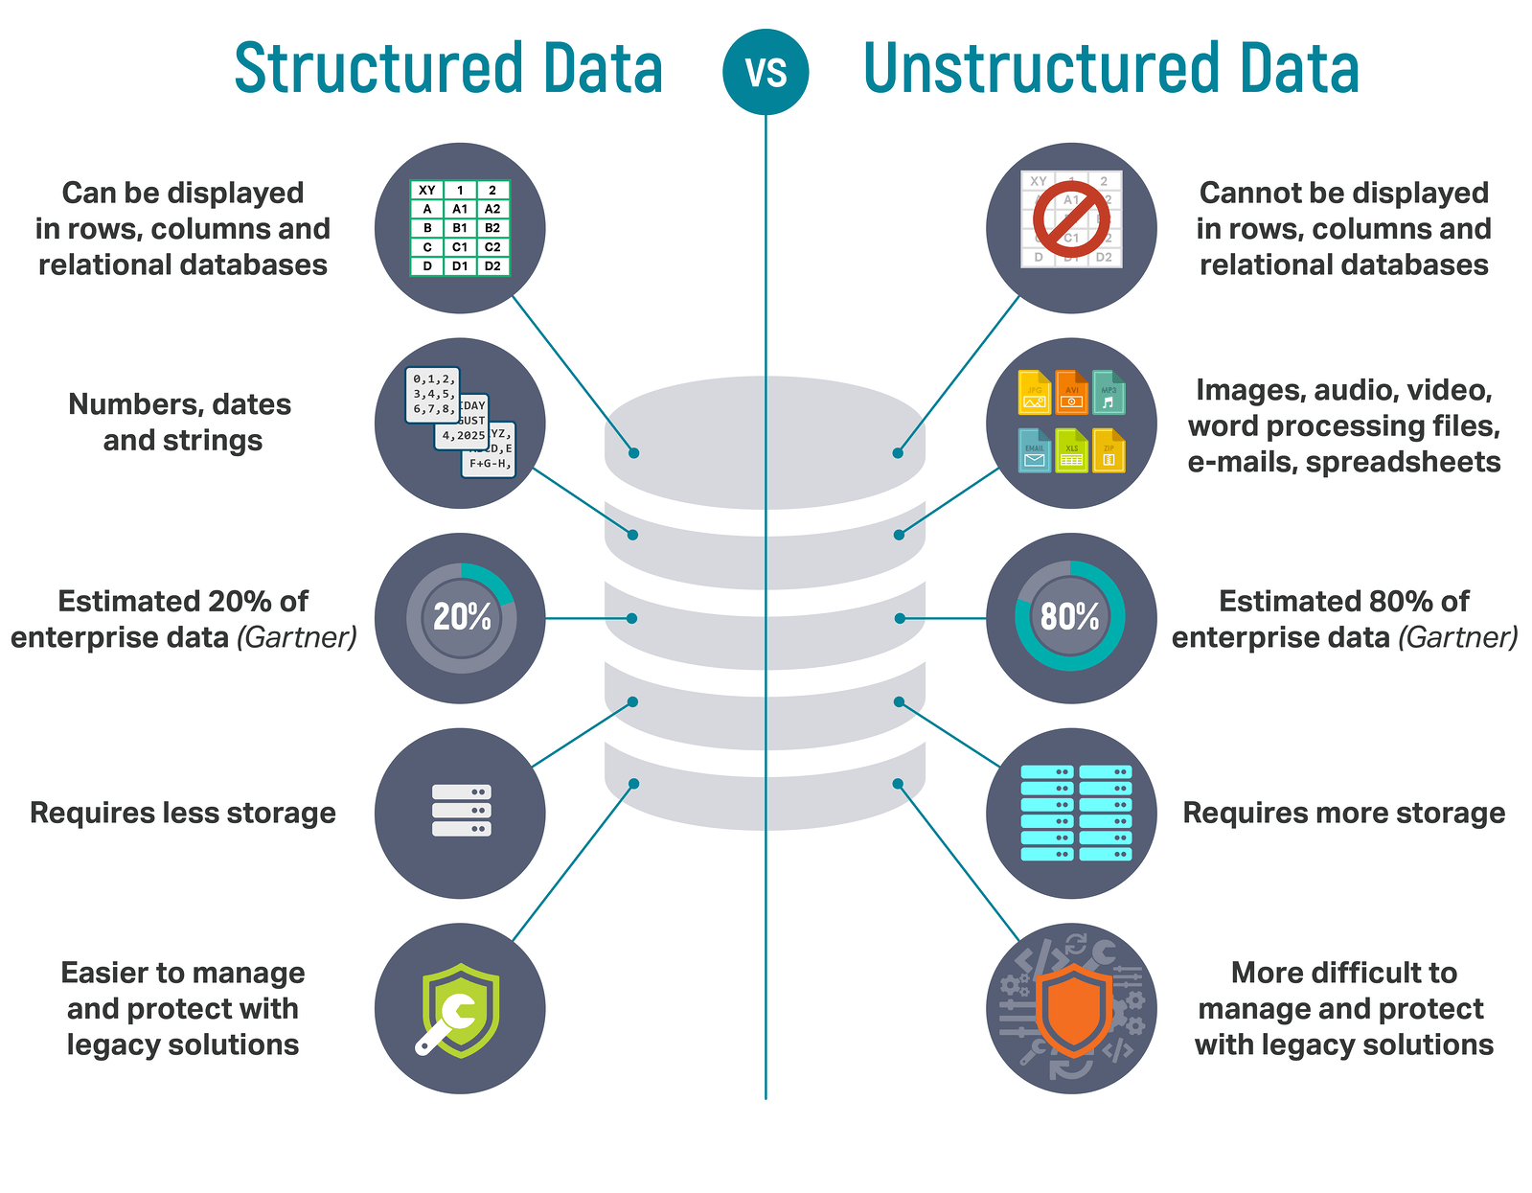
Types of Data
Qualitative Data: Descriptive data (e.g., color, gender).
Quantitative Data: Numerical data (e.g., height, weight).
Structured Data: Organized data (e.g., spreadsheets, databases).
Unstructured Data: Non-organized data (e.g., text, images, video).
Example:
Qualitative: Names of products in a catalog.
Quantitative: Prices of products in a catalog.

Slide 5
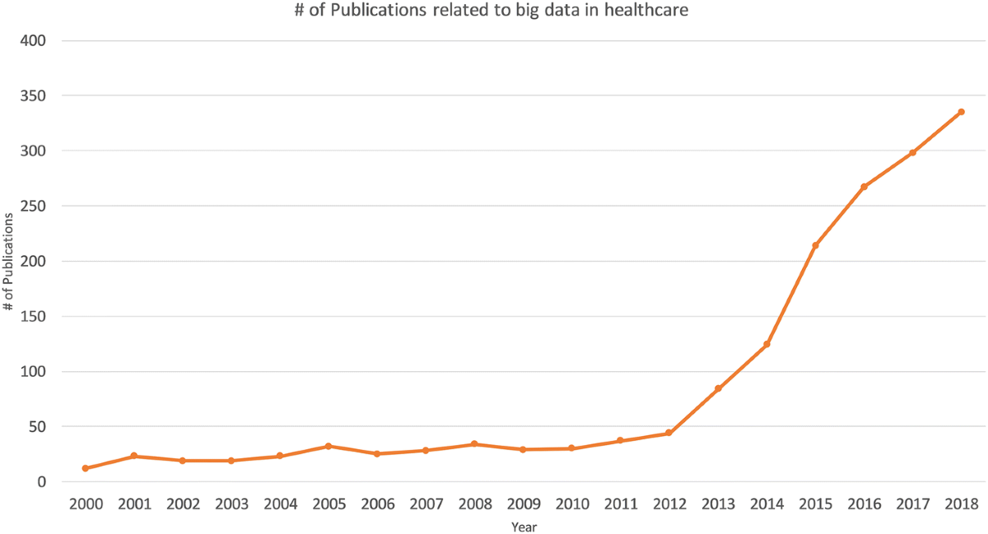
Key Challenges in Data Science
Data Quality Issues: Missing or incorrect data.
Big Data: Managing and processing large datasets.
Data Privacy: Ensuring confidentiality and integrity of data.
Example:
A data set of customer reviews might contain incomplete or erroneous data.

Slide 6
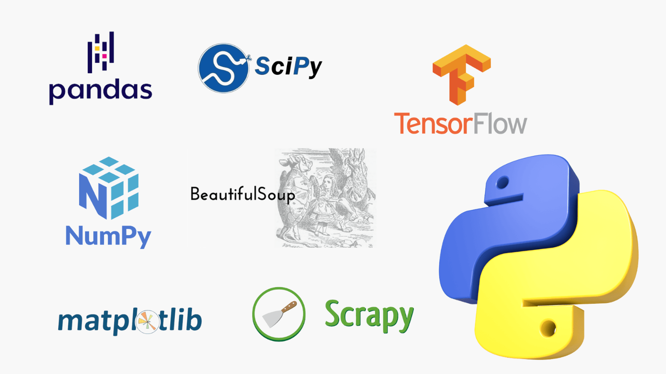
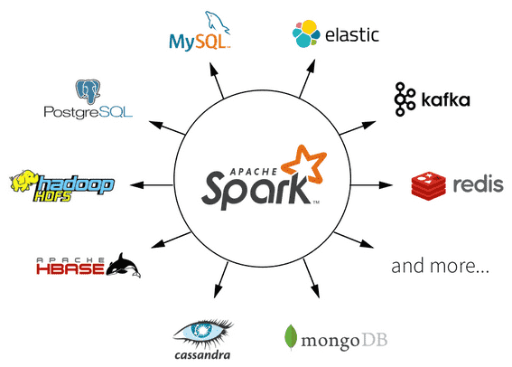
Tools and Technologies for Data Science
Programming Languages: Python, R, SQL.
Libraries/Frameworks: scikit-learn, TensorFlow, Pandas.
Big Data Tools: Hadoop, Spark.

